Slide 1

BUILDTECH
A CONSTRUCTION MANAGMENT SYSTEM
By: Lena Nemah Dabbah
ID: 209140268

Slide 2

Welcome To Our Project
BuildTech is a comprehensive construction project management system designed specifically to streamline the management of construction projects. It is intended for managers and administrators who are responsible for overseeing and tracking the progress of construction projects from start to finish and maintaining safety which is the important part I want to emphasize and present in this document .

Slide 3

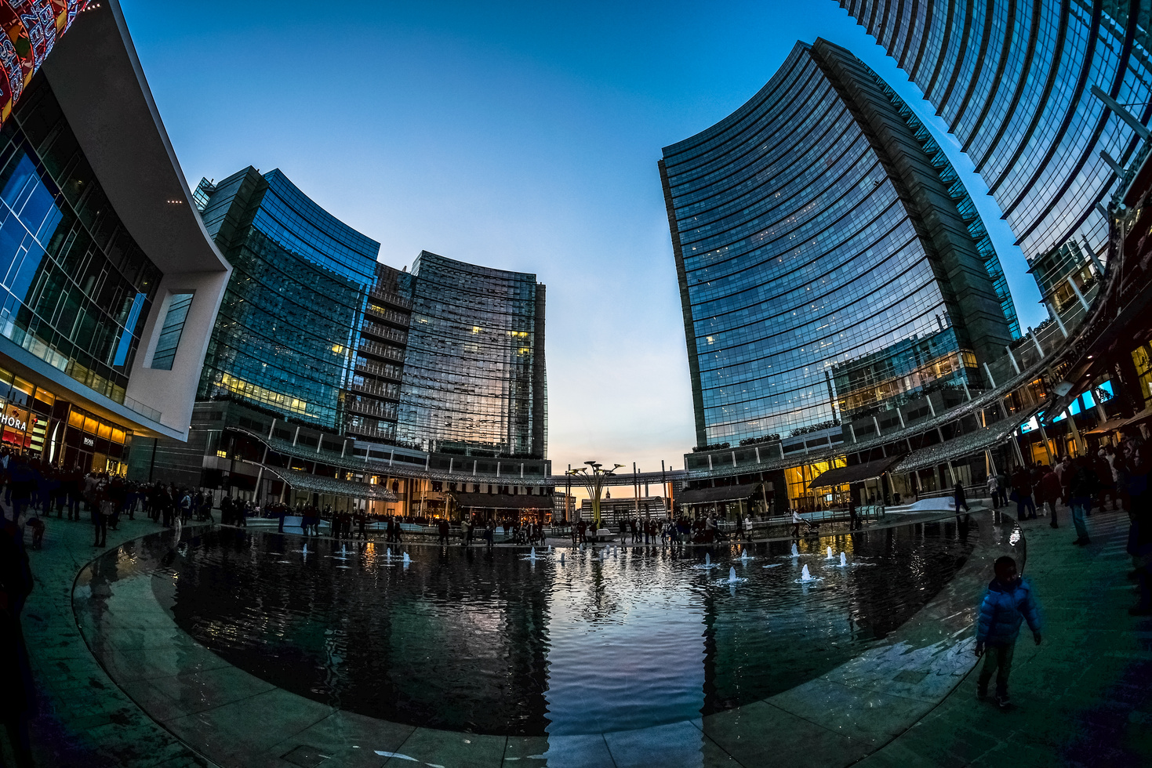
Table Of Contents
Welcome Message
Table Of Contents
Glossary
Our Service
Backend
Frontend
Database
Machine Learning Integration
Infrastructur
Main Pages And Their Functions
Second Version
Tools and Technologies Used
How To Run The System
Project Structure OverView
Machine Learning Components
Testing The System
Previous Version Developer Guide
Contact Us

Slide 4

Glossary -
System Structure & Navigation
Term | Description
BuildTech | The name of the system – a construction project management and safety monitoring platform.
Landing Page | The first page of the website, accessible to all users. Contains navigation and a contact form.
Manager Login | A secure area accessible only to authorized managers or administrators.
Navbar | Navigation bar located on the right side of the screen after login, used to move between system pages.
Dashboard | The home view after login, showing summaries like project lists, task status, maps, and charts.
Project Details Page | A page showing full project info, including its location, attached files, and image upload

Slide 5
Glossary -
Safety & Image Analysis
Term | Description
Not Analyzed | A status for uploaded images that have not yet been reviewed by the safety detection system.
Safety Analysis | An automated process that checks images using a Machine Learning model to detect safety gear.
ML (Machine Learning) | A method that enables the system to analyze images and detect whether safety measures are followed.
PDF Report | A file generated by the system after analysis, showing which images include safety issues.

Slide 6
Glossary -
Technical Components
Term | Description
PHPMailer | A PHP library used to send the email reports with attachments (like PDF).
XAMPP | A local development environment that includes Apache, PHP, and MySQL for testing the system.
phpMyAdmin | A tool used to manage the MySQL database through a web interface.
API | Application Programming Interface – used to allow different parts of the system (or external tools) to communicate.
Cron Job | A scheduled task (every 1 hour) that triggers the safety image analysis script.

Slide 7


Our Service
The BuildTech system consists of multiple technologies and over 30 pages. The system is modular and organized in different folders according to functionality.
BuildTech is a web-based construction project management system designed primarily for site managers and administrative staff.
The core service of the system is:
🔍 Maintaining safety on construction sites by analyzing images using a machine learning model.

Slide 8

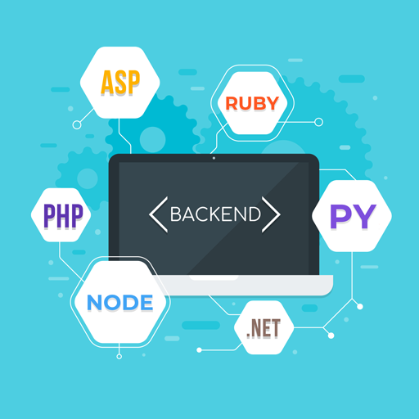
📦 Backend
PHP – The core backend logic and server-side processing are written mostly in PHP.
JavaScript –Used to dynamically populate HTML elements with PHP variables, handle form submissions using AJAX (without refreshing the page), display modals, update project steps and payment information, delete files, upload files, format numbers with commas and currency, reload the page after actions, and render dynamic charts with project data..
Python – Used in a limited number of scripts, mainly for machine learning tasks and image analysis.

Slide 9

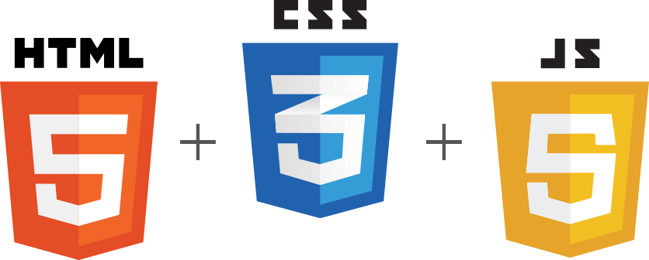
🎨 Frontend
HTML – Defines the structure of the pages.
CSS – Used for styling and layout of the interface.
JavaScript – Provides interactivity and communicates with backend components.

Slide 10
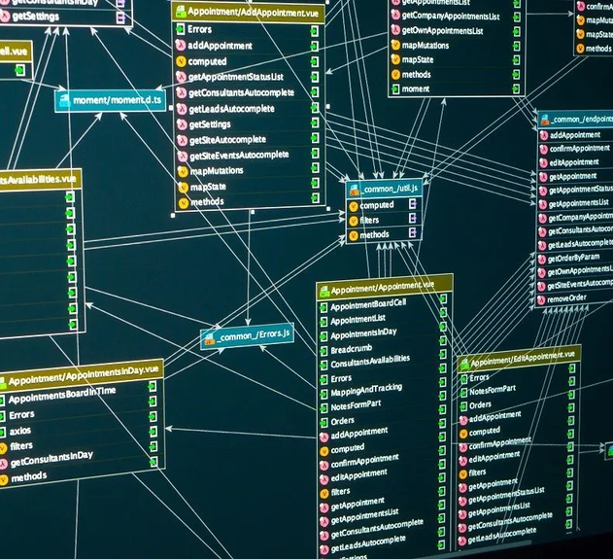
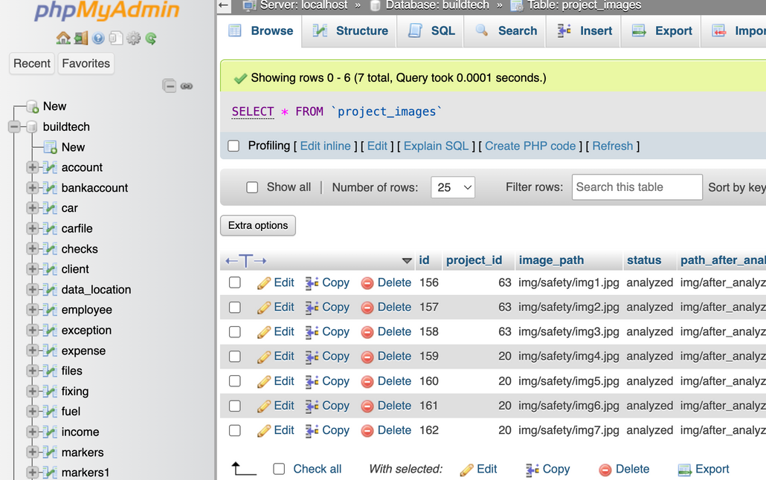

🗃️ Database
MySQL – Used as the main relational database to store users, projects, tasks, images, and system configurations.
Managed via phpMyAdmin within XAMPP environment.

Slide 11


🤖 Machine Learning Integration
A YOLO-based object detection model, implemented in Python, is responsible for analyzing uploaded images and identifying safety compliance (e.g., hardhats, vests, masks). The model was trained using a labeled construction site safety dataset from Kaggle. Image analysis is triggered automatically by a scheduled task (such as a cron job), ensuring regular and efficient safety checks.

Slide 12
🛠️ Infrastructure
XAMPP is used as the local development environment, including Apache server and MySQL database.
The system runs locally but is structured in a way that can be easily deployed to a remote server.

Slide 13
Main Pages and Their Functions
File/Page Name | Description
no_log_in.php | The landing page for the system. Users can access it to start the login process.
index.php | The login page where users enter their credentials (username/password) to access the system.
home.php | The homepage for managers after they log in, displaying an overview or dashboard for managing projects and other system functionalities.
projects.php | Displays a list of all projects stored in the database, allowing managers to select a specific project for further actions.
project.php | A project details page, showing detailed information about a selected project (e.g., project name, status, etc.), and allowing further interactions like uploading images.
upload_handler.php | Handles image uploads related to projects, storing them in the database with a status of not_analyzed.
check_images.php | Analyzes the uploaded images with a status of not_analyzed, calls a Python script to process the images, and generates a PDF report with analysis results and send a mail to : lena.mhamed@hotmail.com
call_check_images.py | A Python script that serves as a utility to invoke the check_images.php script for processing images. It likely prepares data for checking and triggering the analysis process.
analyze_image.py | The Python script that actually analyzes images related to construction site safety using YOLO (You Only Look Once) model. It detects safety equipment and unsafe conditions in images, marking unsafe ones for reporting.

Slide 14
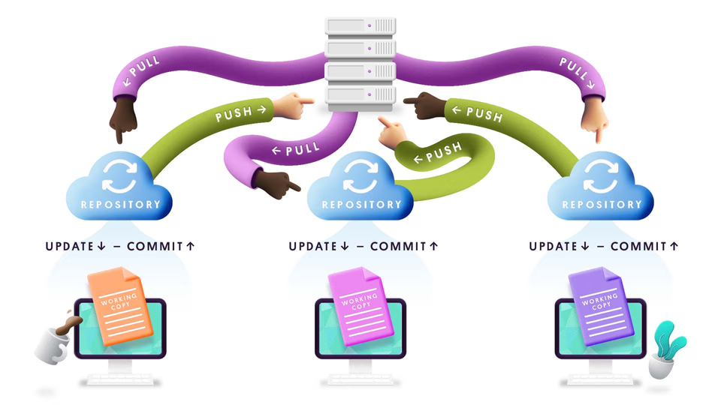
Second Version
This is the exciting second version of the system, where we've introduced enhanced safety features and a sleek design overhaul to support Hebrew. While this version brings these new additions, I will also be including the original developer guide from the first version for reference, so you have everything you need to work with the complete system.

Slide 15
Tools and Technologies Used
Tool / Technology | Description
Visual Studio Code (VSCode) | The main code editor used for writing and managing the project files, including PHP, HTML, CSS, JavaScript, and Python.
XAMPP | A local server environment used to run Apache and MySQL, enabling local hosting of the PHP-based web system.
MySQL + phpMyAdmin | MySQL was used as the database management system. phpMyAdmin provided a user-friendly web interface to manage databases.
Git | Used for version control, allowing collaborative development and tracking of changes in the codebase.
Python (with virtual environment) | Used for image analysis scripts, including AI-based safety checks for images.
Google Chrome | Used primarily for testing and debugging the system in a browser environment.

Slide 16

HOW TO RUN THE PROJECT

Slide 17

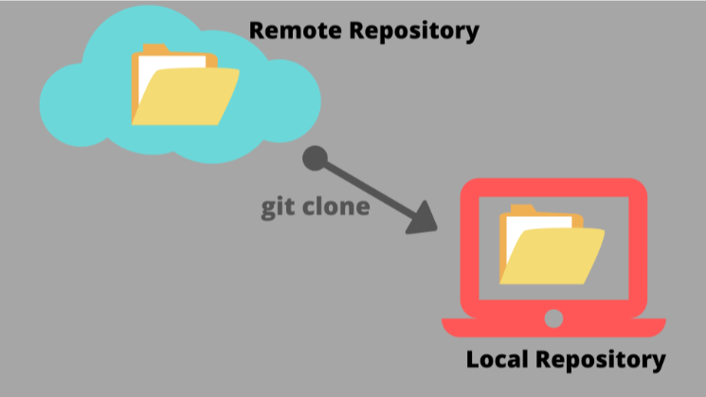
Clone and Place the Project
Download or clone the project from GitHub.
Place the project folder inside the htdocs directory of your XAMPP installation (typically: C:\xampp\htdocs\).

Slide 18

Set Up the Database
Open phpMyAdmin by visiting http://localhost/ in your browser and clicking on phpMyAdmin.
In Task Manager, make sure mysql.exe is not already running (to avoid conflicts).
In XAMPP, start both Apache and MySQL.
In phpMyAdmin:
Click New in the left sidebar.
Create a database with the exact name: buildtech.
Click on the new database name, then go to the Import tab.
Import the SQL file from the project directory (buildtech.sql).

Slide 19

Python Setup
Ensure Python is installed on your system.
Open Command Prompt (CMD) and run where python to locate your Python path.
In the check_images.php file, update the $pythonPath variable with your actual Python path (e.g., C:\\Users\\yourname\\AppData\\Local\\Programs\\Python\\Python311\\python.exe).
Install Python Dependencies
Open terminal or CMD and install required packages:
pip install ultralytics

Slide 20

PHP and Composer Configuration
Ensure all required PHP extensions are enabled in your php.ini file under XAMPP > Config.
If mpdf doesn’t work, try the following:
composer clear-cache
composer remove mpdf/mpdf
composer require mpdf/mpdf
If you get a TMP folder error, try to run:
rmdir /s /q tmp
mkdir tmp\mpdf

Slide 21

Git Installation
Make sure Git is installed on your system to manage version control.

Slide 22

Running the System
To launch the system locally:
Open your browser.
In the address bar, type:
localhost/[nameOfTheProject]/
Replace [nameOfTheProject] with the actual folder name you placed in htdocs (e.g., buildtech).
This will open the landing page of the system.
To automatically check for new images that need to be analyzed every hour, run the following command in your terminal:
python call_check_images.py

Slide 23
Project Structure Overview
buildtech/
│
├── analyze_image.py # Python script that analyzes an image using YOLO
├── call_check_images.py # Python script that runs check_images.php every hour
├── check_images.php # PHP page to analyze new images and generate/send PDF report
├── upload_handler.php # Handles image uploads and saves info to the database
├── project.php # Shows details of a specific project
├── projectsTable.php # Displays a table with all projects
├── home.php # Homepage after login (dashboard for users)
├── no_log_in.php # Shown to users who try to access restricted pages without logging in
├── index.php # Landing/login page of the system
├── buildtech.sql # Database dump file (import this into phpMyAdmin)
├── /img/ # Folder where uploaded images are stored
├── /vendor/ # Composer dependencies (includes mPDF)
├── /tmp/mpdf/ # Temporary folder needed by mPDF for PDF generation

Slide 24

🤖 Machine Learning Components
This system integrates a custom-trained YOLOv5 model to detect safety-related elements on construction sites (e.g., hardhats, masks, safety vests). The following components are used:
🔧 Training Script
train_model.py:
Script used to train the YOLO model. It was either used previously before the system was built, or can be used to retrain the model if needed.

Slide 25
🤖 Machine Learning Components
📁 Model Results Directory
detect/safety_model322/:
Contains training outputs, evaluation metrics, and visualizations:
Curves & Metrics: F1_curve.png, PR_curve.png, P_curve.png, R_curve.png, confusion_matrix.png, etc.
Training Samples: train_batch*.jpg – sample images from training batches.
Validation Samples: val_batch*_labels.jpg, val_batch*_pred.jpg – shows predictions vs ground truth.
Model Weights:
best.pt: Best-performing YOLO model saved during training.
last.pt: Final model after last epoch.

Slide 26
🤖 Machine Learning Components
📁 Validation Results Directory
detect/val/:
Additional validation performance visuals.

Slide 27
🧪 Testing the System
To test the safety image analysis and report system, follow these steps:
✅ 1. Upload New Images
Go to the project.php page.
Select a project and upload new images related to the construction site.
These images are:
Saved physically in the folder:
img/safety/
Registered in the project_images table in the database.
The database saves the path of each image, which is used later for analysis.
The status is set to:
status = 'not_analyzed'
The after_analyzing field is left null until the image is processed.

Slide 28
🧪 Testing the System
🔄 2. Run the Image Checker Script
Open your terminal in VSCode and run:
python call_check_images.py
This script calls the check_images.php page every hour.
It checks the database for new images with status = 'not_analyzed'.
🧠 3. How the System Works
Once new images are detected:
The YOLO model processes them to detect safety equipment (e.g., hardhat, vest).
Annotated images are saved, and the after_analyzing path is updated in the database.
A PDF report is generated, organizing the images by their related projects.
The report is emailed to: lena.mhamed@hotmail.com

Slide 29
Previous Version Developer Guide
The developer guide for the previous version of this project is included in the project folder under:
bash
CopyEdit
/guide_v1
This guide contains details about the original system, including its setup, configuration, and usage. It serves as a reference for understanding the earlier version of the project, and you can compare it with the new version to track the updates and improvements made.

Slide 30


Contact Us
+972546353123
Lena.mhamed@hotmail.com

Slide 31

THANK YOU

